Slide 1
Chapter 11
Introduction to PHP
Programming the World Wide Web
Fourth edition
By Robert W. Sebesta

Slide 2
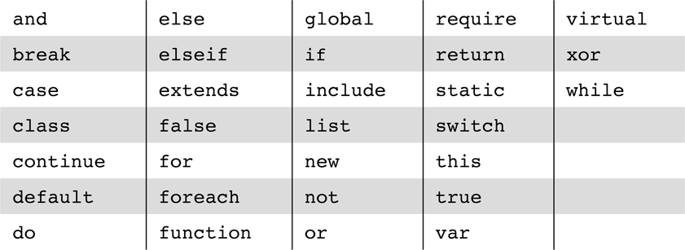
Table 11.1 The reserved words of PHP

Slide 3
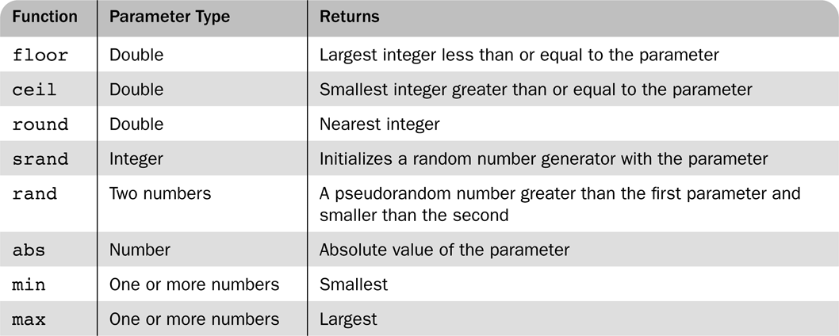
Table 11.2 Some useful predefined functions

Slide 4
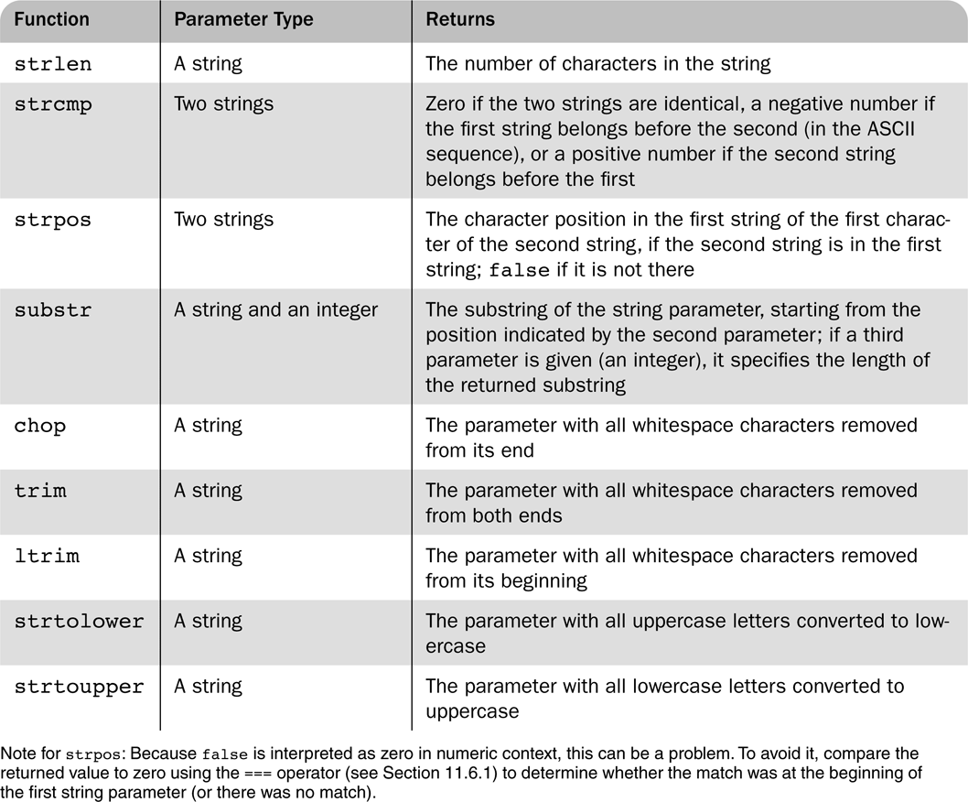
Table 11.3 Some commonly used string functions

Slide 5
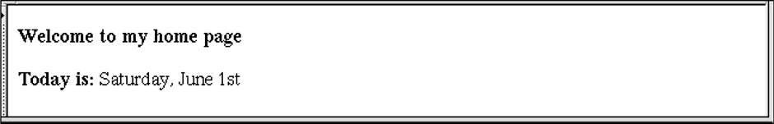
Figure 11.1 Display of the output of today.php

Slide 6
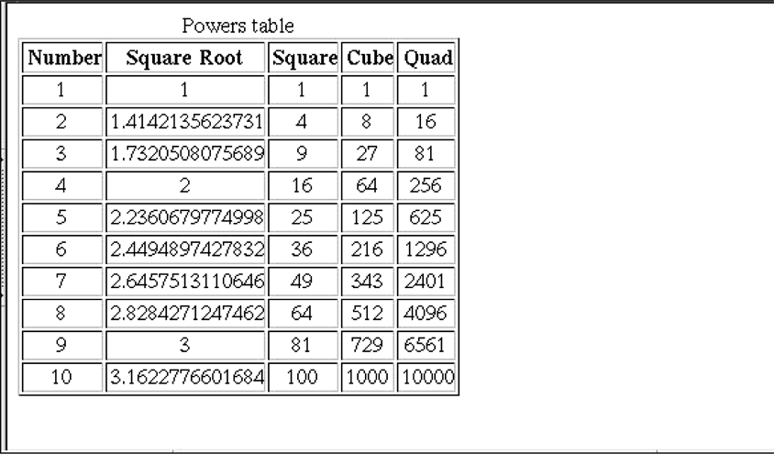
Figure 11.2 The output of powers.php

Slide 7
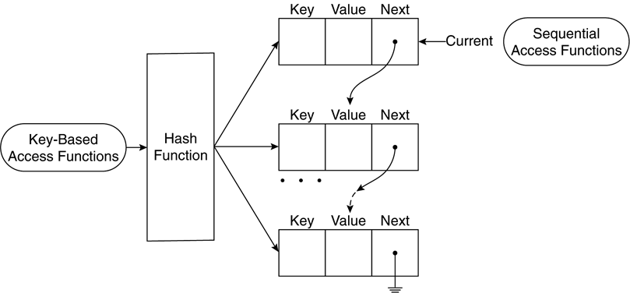
Figure 11.3 Logical internal structure of arrays

Slide 8
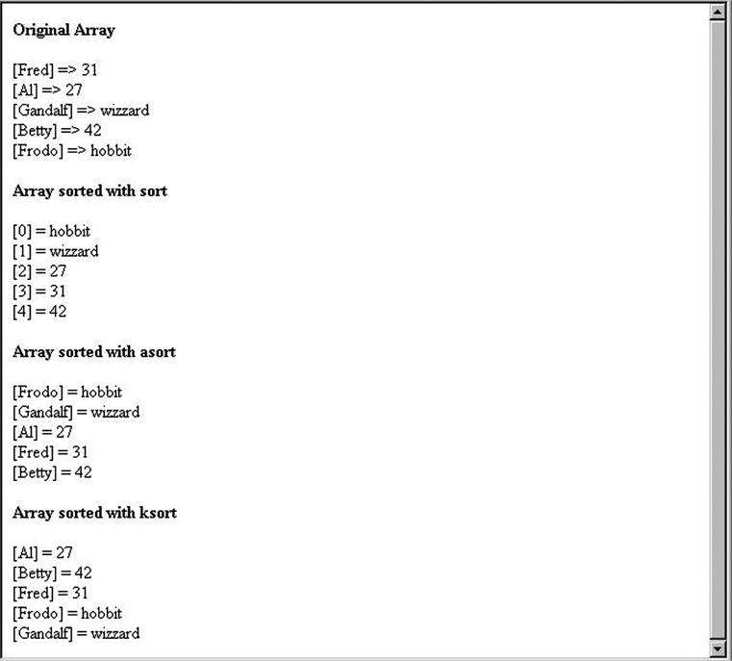
Figure 11.4 The output of sorting.php

Slide 9
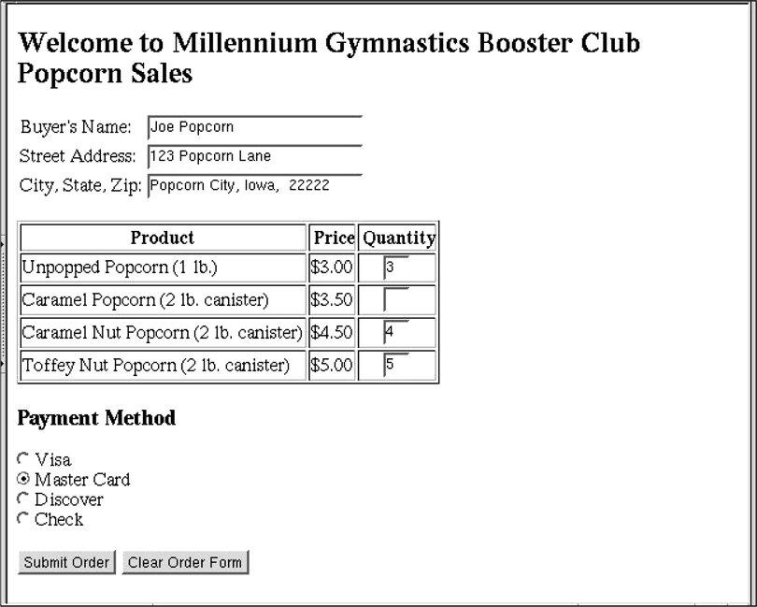
Figure 11.5 The display of popcorn3.html

Slide 10
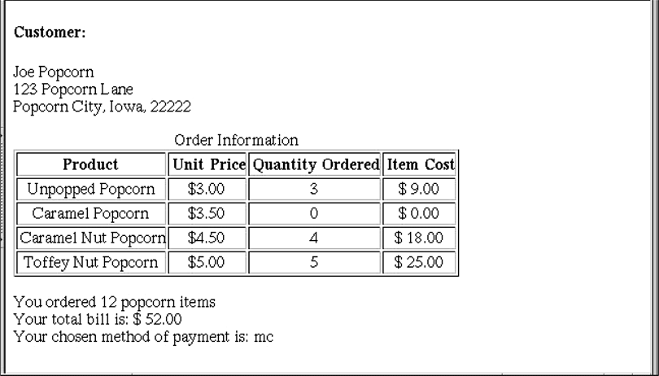
Figure 11.6 The output of popcorn3.php

Slide 11
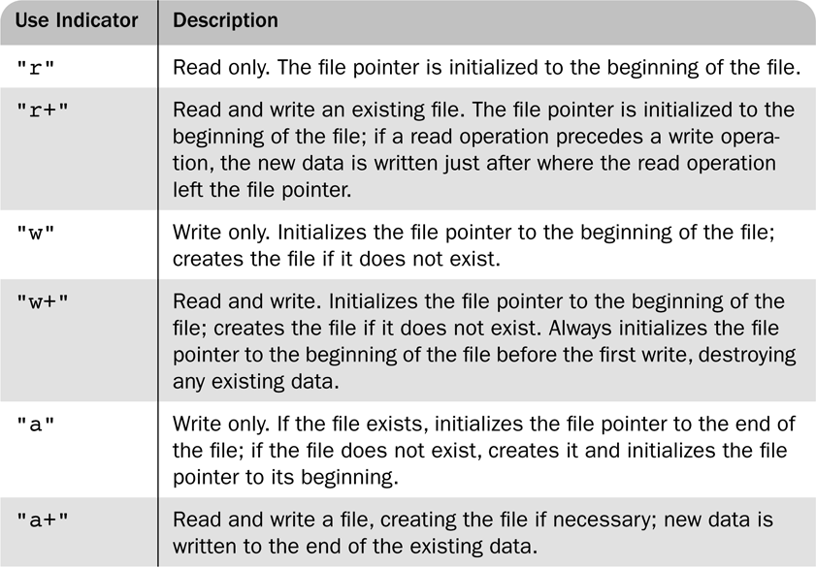
Table 11.4 File use indicators

